Slide 1

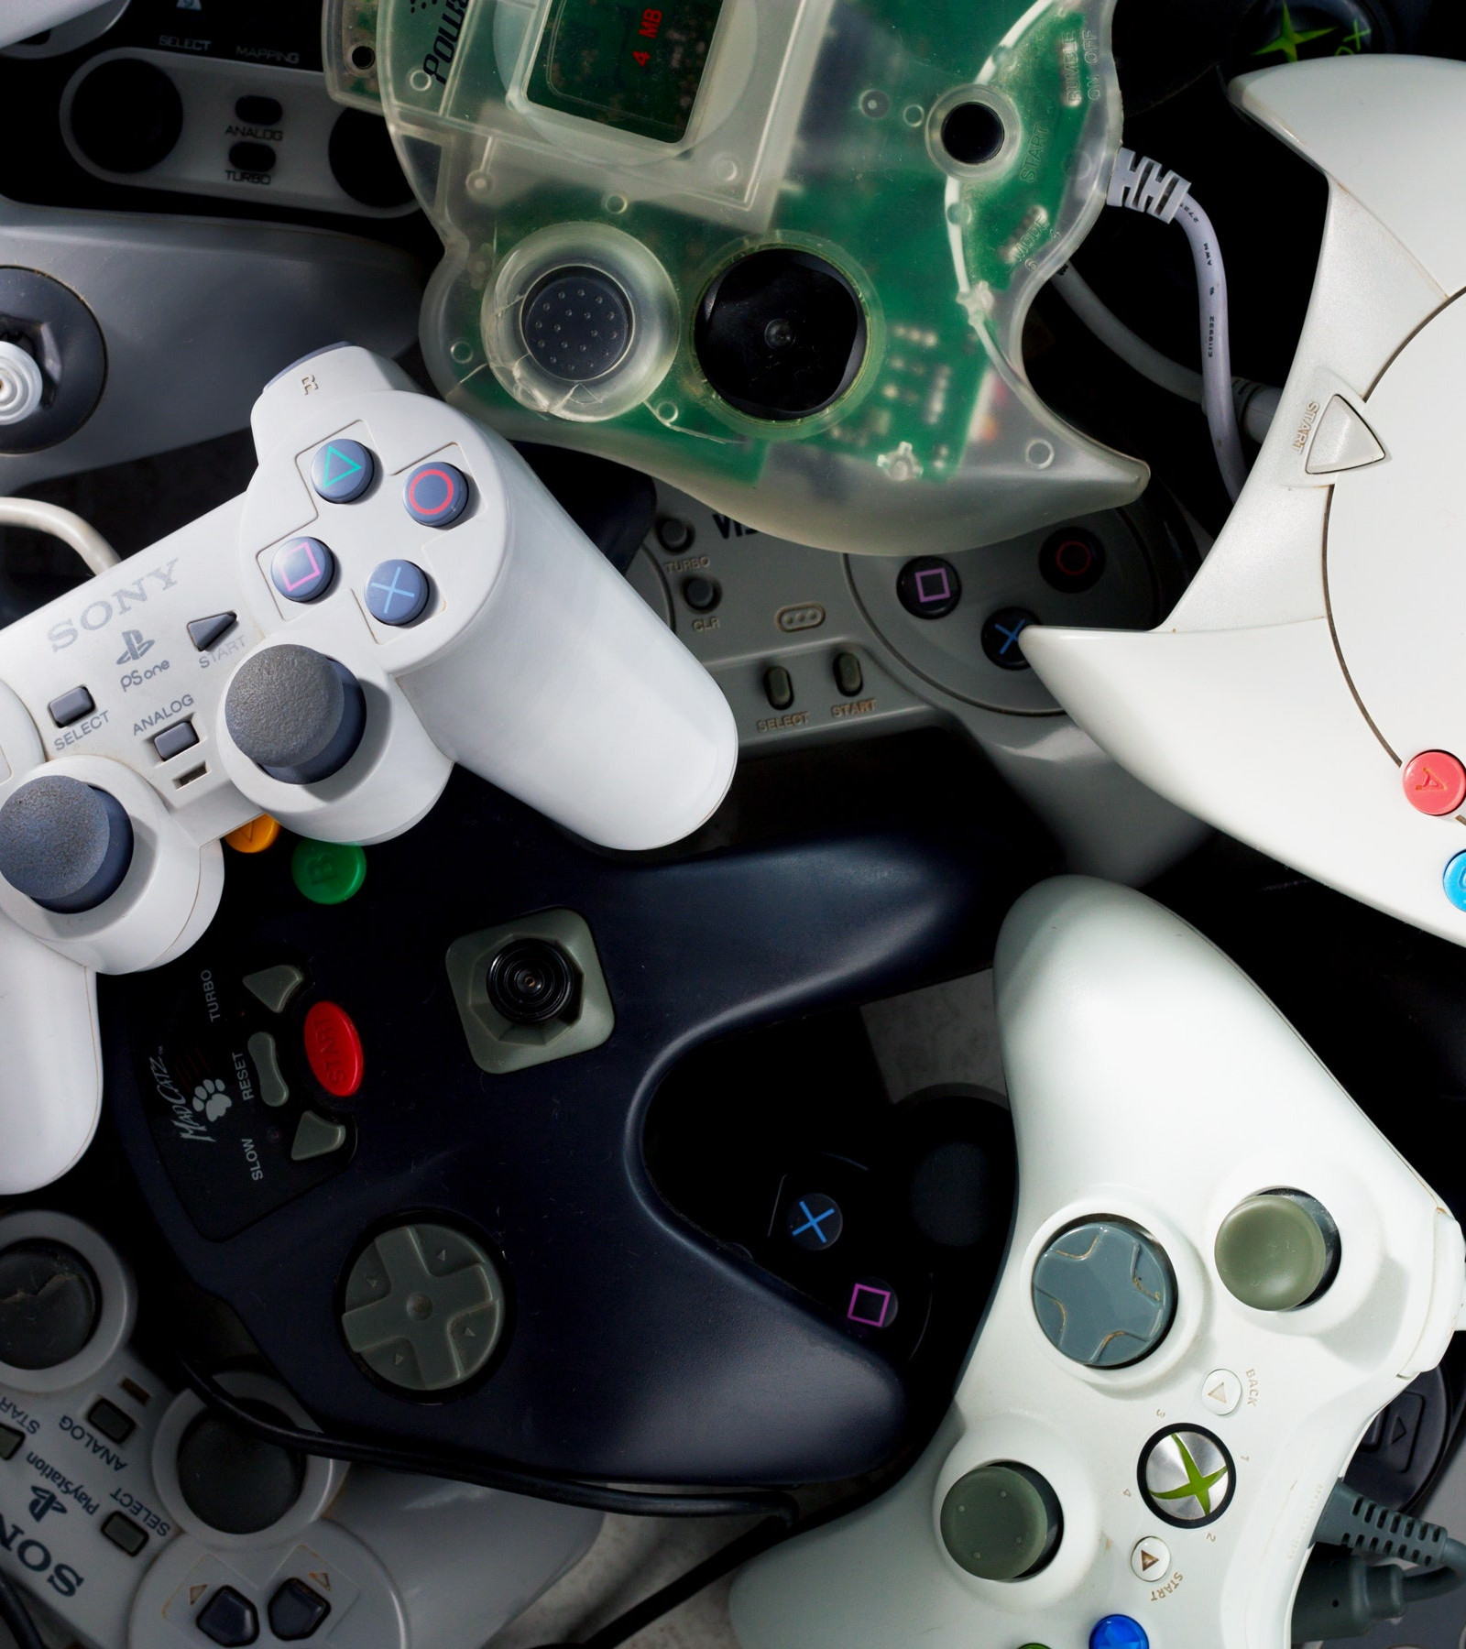
Video Game Sales
Bradley Beck

Slide 2
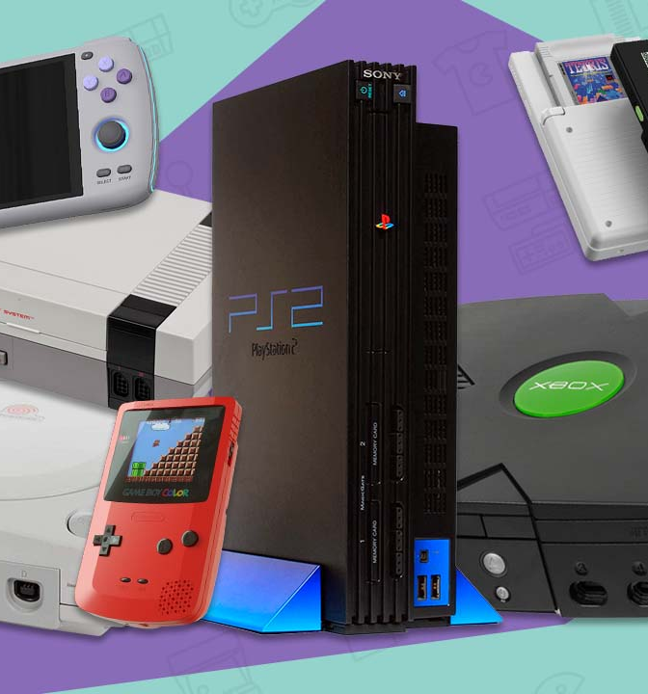
Overview
Different video games and consoles are sold all over the world
How do these sales vary in different locations?
What Genre of games are most popular across the globe?
Do any regions have similarities in sales?

Slide 3
Column Description
Rank - Ranking of overall sales
Name - The games name
Platform - Platform of the games release (i.e. PC,PS4, etc.)
Year - Year of the game's release
Genre - Genre of the game
Publisher - Publisher of the game
NA_Sales - Sales in North America (in millions)
EU_Sales - Sales in Europe (in millions)
JP_Sales - Sales in Japan (in millions)
Other_Sales - Sales in the rest of the world (in millions)
Global_Sales - Total worldwide sales.

Slide 4
Checking for NA’s
Rank 0
Name 0
Platform 0
Year 271
Genre 0
Publisher 58
NA_Sales 0
EU_Sales 0
JP_Sales 0
Other_Sales 0
Global_Sales 2

Slide 5
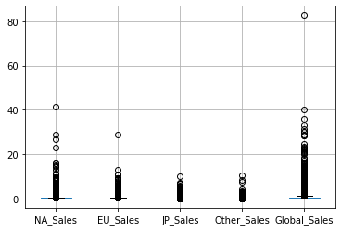
Exploring Outliers from Sales
These outliers identify sales that typically did not sell well in
these areas however did in these instances
Platform sales
Genre sales
Publisher sales

Slide 6
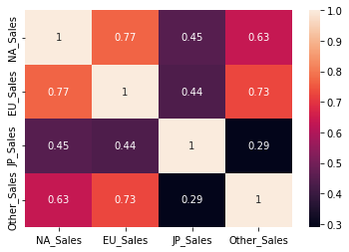
Correlation of Sales Across the Globe
Sales in North America and Europe are very similar
Outside of North America, Europe and Japan sales are
the most correlated to Europe
Video game sales in Japan are not alike the rest of the
world

Slide 7
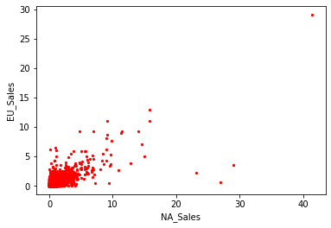
Sale Similarity Between North America and Europe
Majority of sales in North America and Europe resulted in
similar profits
Previously seen on the heat map these sales are 77%
correlated to one another

Slide 8
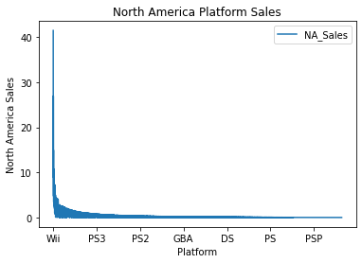
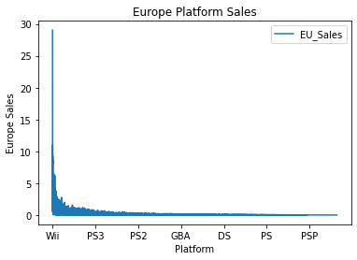
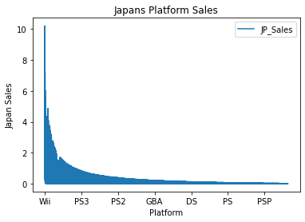
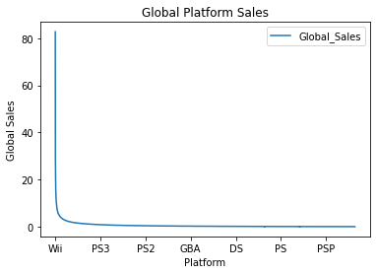
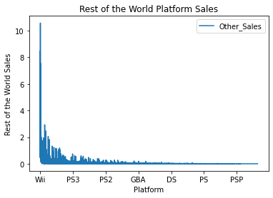
Platform Sales in Different Locations

Slide 9

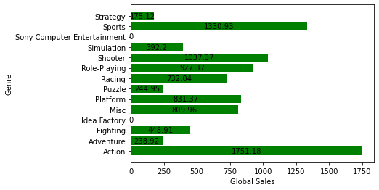
Video Game Genre’s Global Sales
= Action Games
Across the globe action games tend
to sell the best while strategic games are
the least sold

Slide 10

Conclusion
Video game sales vary based on different locations of the world
Culture
North America and Europe have the most correlated sales across the globe
Action games are the highest sold genre worldwide
The Wii is the best-selling console in each region
Japan purchases the most amount of consoles

